Slide 1



FOODONIC
Bite Into Speed & Flavor!

Slide 2

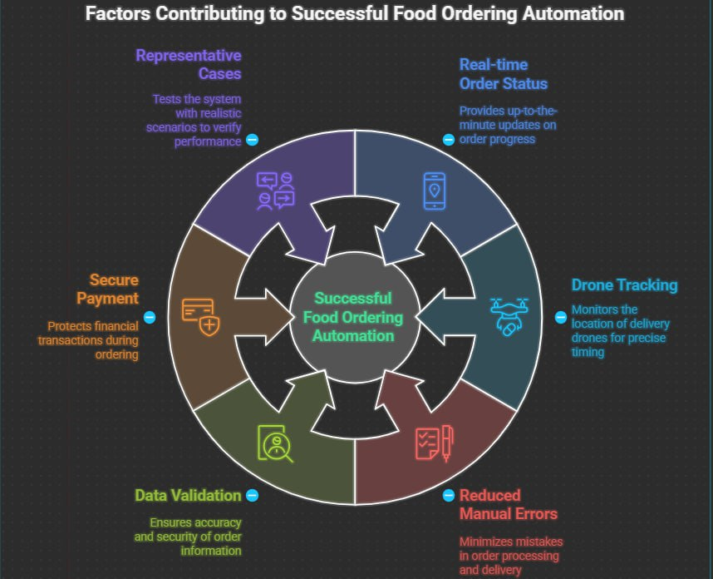
Accuracy of Result
The Online Food Ordering System (OFOS) uses a MySQL database to ensure accurate, reliable, and real-time management of customer, menu, payment, and delivery data. It maintains referential integrity with primary and foreign keys, minimizes redundancy, prevents manual errors, and synchronizes updates instantly—such as order confirmations, payments, and drone locations—while automatically validating all data entries for consistency

Slide 3
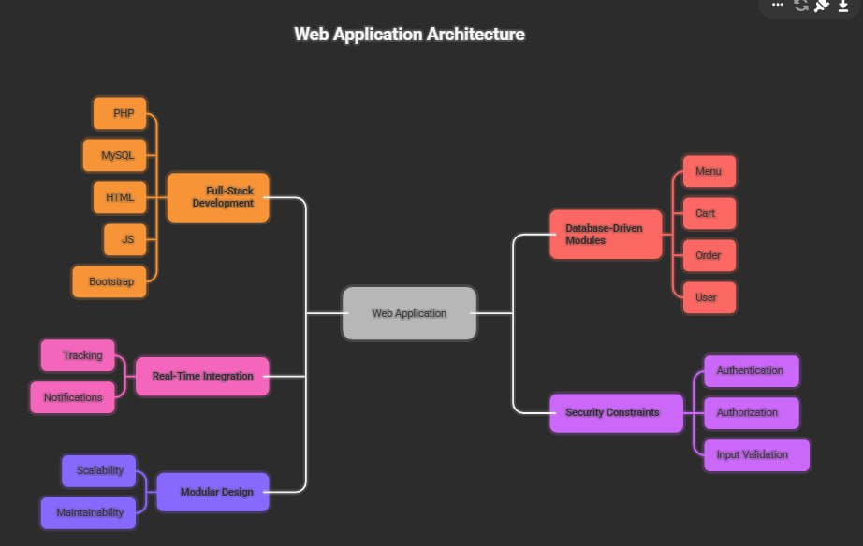

Technical Competence
The project demonstrates expertise in software and database management by integrating a frontend interface with a MySQL backend for seamless data handling. It features CRUD operations, joins, and normalization for efficiency, along with stored procedures and triggers for automation. Secure authentication protects user data, while IoT-enabled drone tracking and GPS modules provide real-time delivery updates.

Slide 4
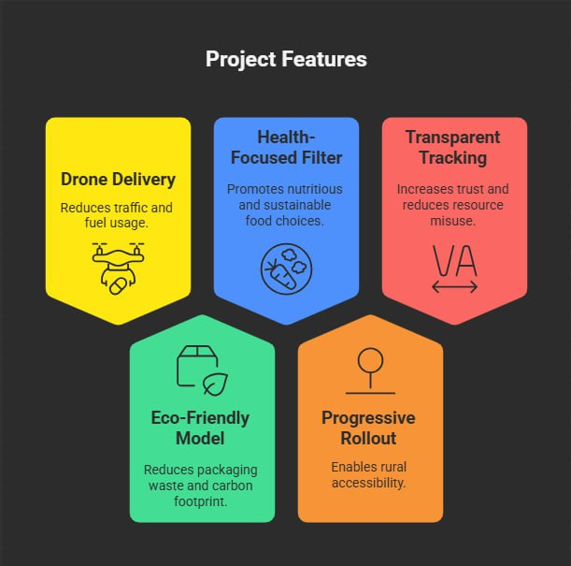

Innovative and Sustainable Features
The OFOS project features an innovative drone-based delivery system that reduces traffic and delays while promoting sustainability through electric drones and eco-friendly packaging. Real-time GPS tracking lets customers monitor deliveries live, and a database-driven recommendation engine supports personalized, healthy food suggestions based on past orders.

Slide 5
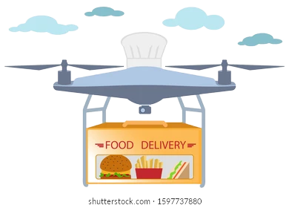
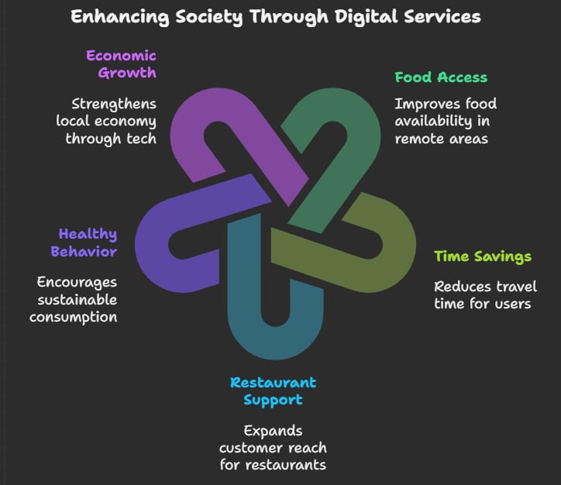
Utility to Society
The project enhances food delivery convenience and hygiene while promoting sustainability and inclusivity. It bridges urban–rural gaps through drone delivery, supports contactless and healthy options, reduces fuel use, empowers small restaurants by expanding their reach, and uses MySQL data analytics to continually improve service quality.

Slide 6
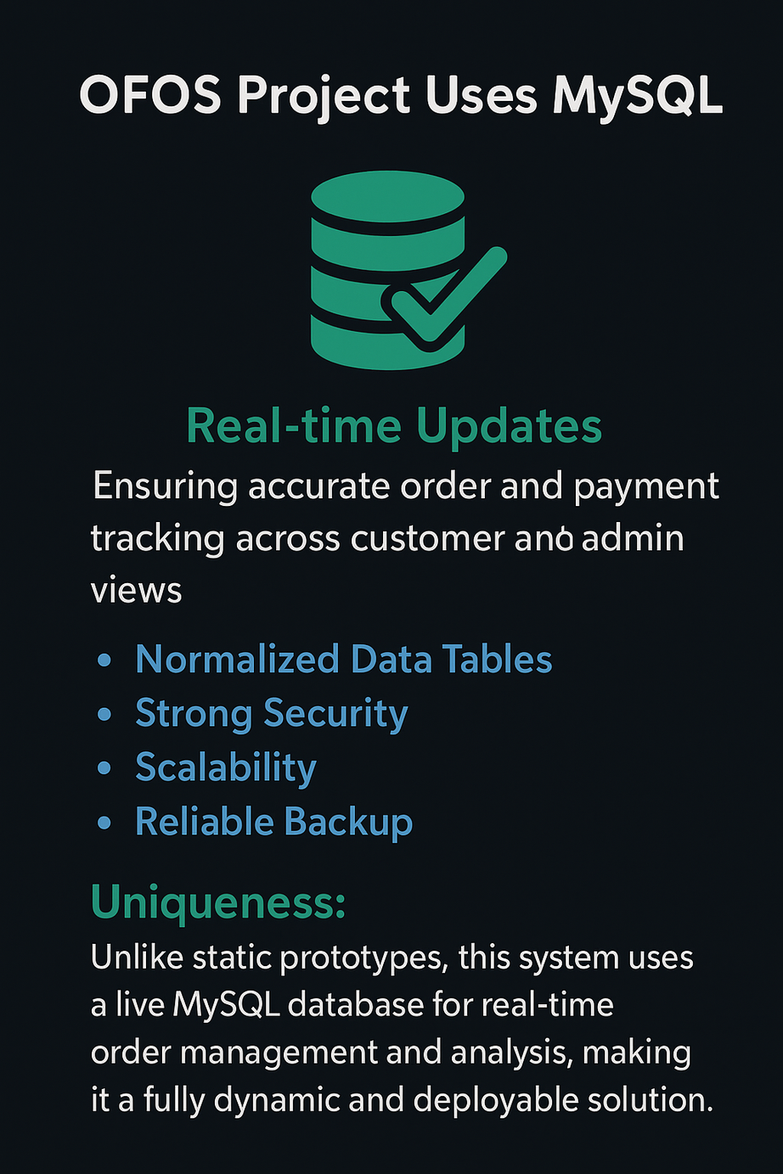
Summary:
The OFOS project uses MySQL for real-time updates, ensuring accurate order and payment tracking across customer and admin views. With normalized data tables, strong security, scalability, and reliable backup features, it operates efficiently and securely.
Uniqueness:
Unlike static prototypes, this system uses a live MySQL database for real-time order management and analysis, making it a fully dynamic and deployable solution.

Slide 7

~ A2 CSE (TEAM 3)
2410030376 - ASHRITHA KAMMARI
2410030034 - SAI PAVANI CHIDURALA
2410030356 - SRUJANA SADHU SHARMA
2410030355 - HARSHITHA ORUGANTI
2410030357 - ASHRITA GAYATRI V
2410040126 - SRAVANI ANNAM

